Slide 1

Getting started…
Please sit in rows A through J only
Form groups of 3-5 students
Discuss: what are you most confused about?
Post questions on Ask For Me!

Slide 2
This week
Confidence intervals & hypothesis testing
What it means to reject the null model
Power and Type II error
Replication
Sampling distribution of PRE and F

Slide 3
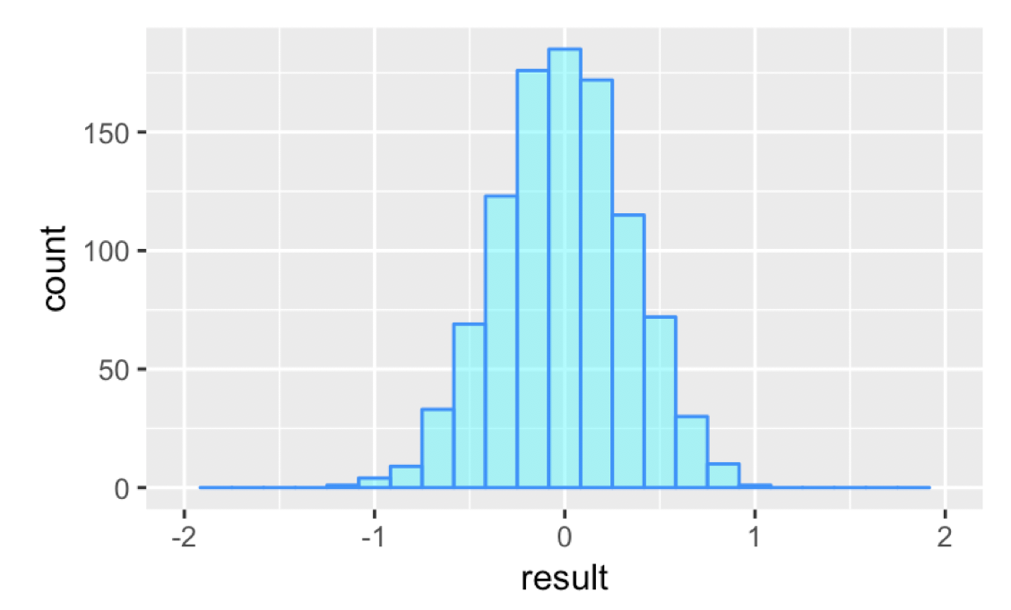
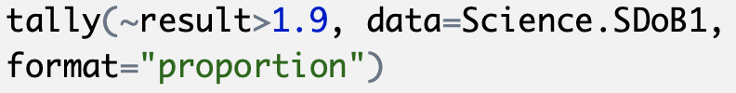
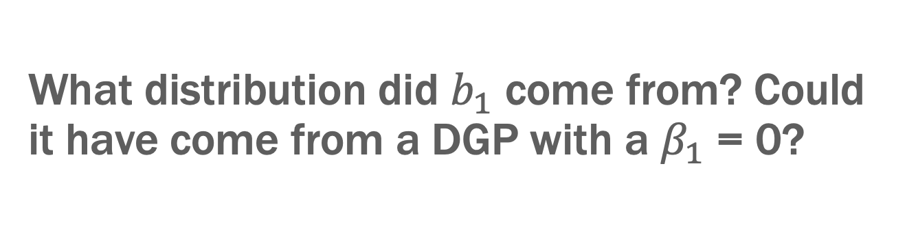
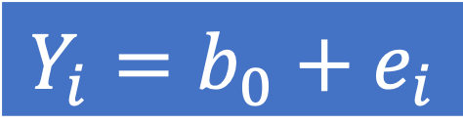
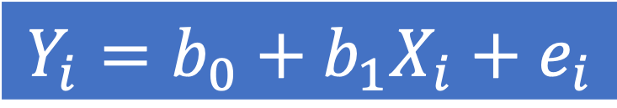
What distribution did $b_{1}$ come from? Could it have come from a DGP with a $β_{1}$ = 0?
$$Y_{i}=b_{0}+b_{1}X_{i}+e_{i}$$
$$Y_{i}=b_{0}+e_{i}$$
p=.000
Sampling distribution for the empty model

Slide 4
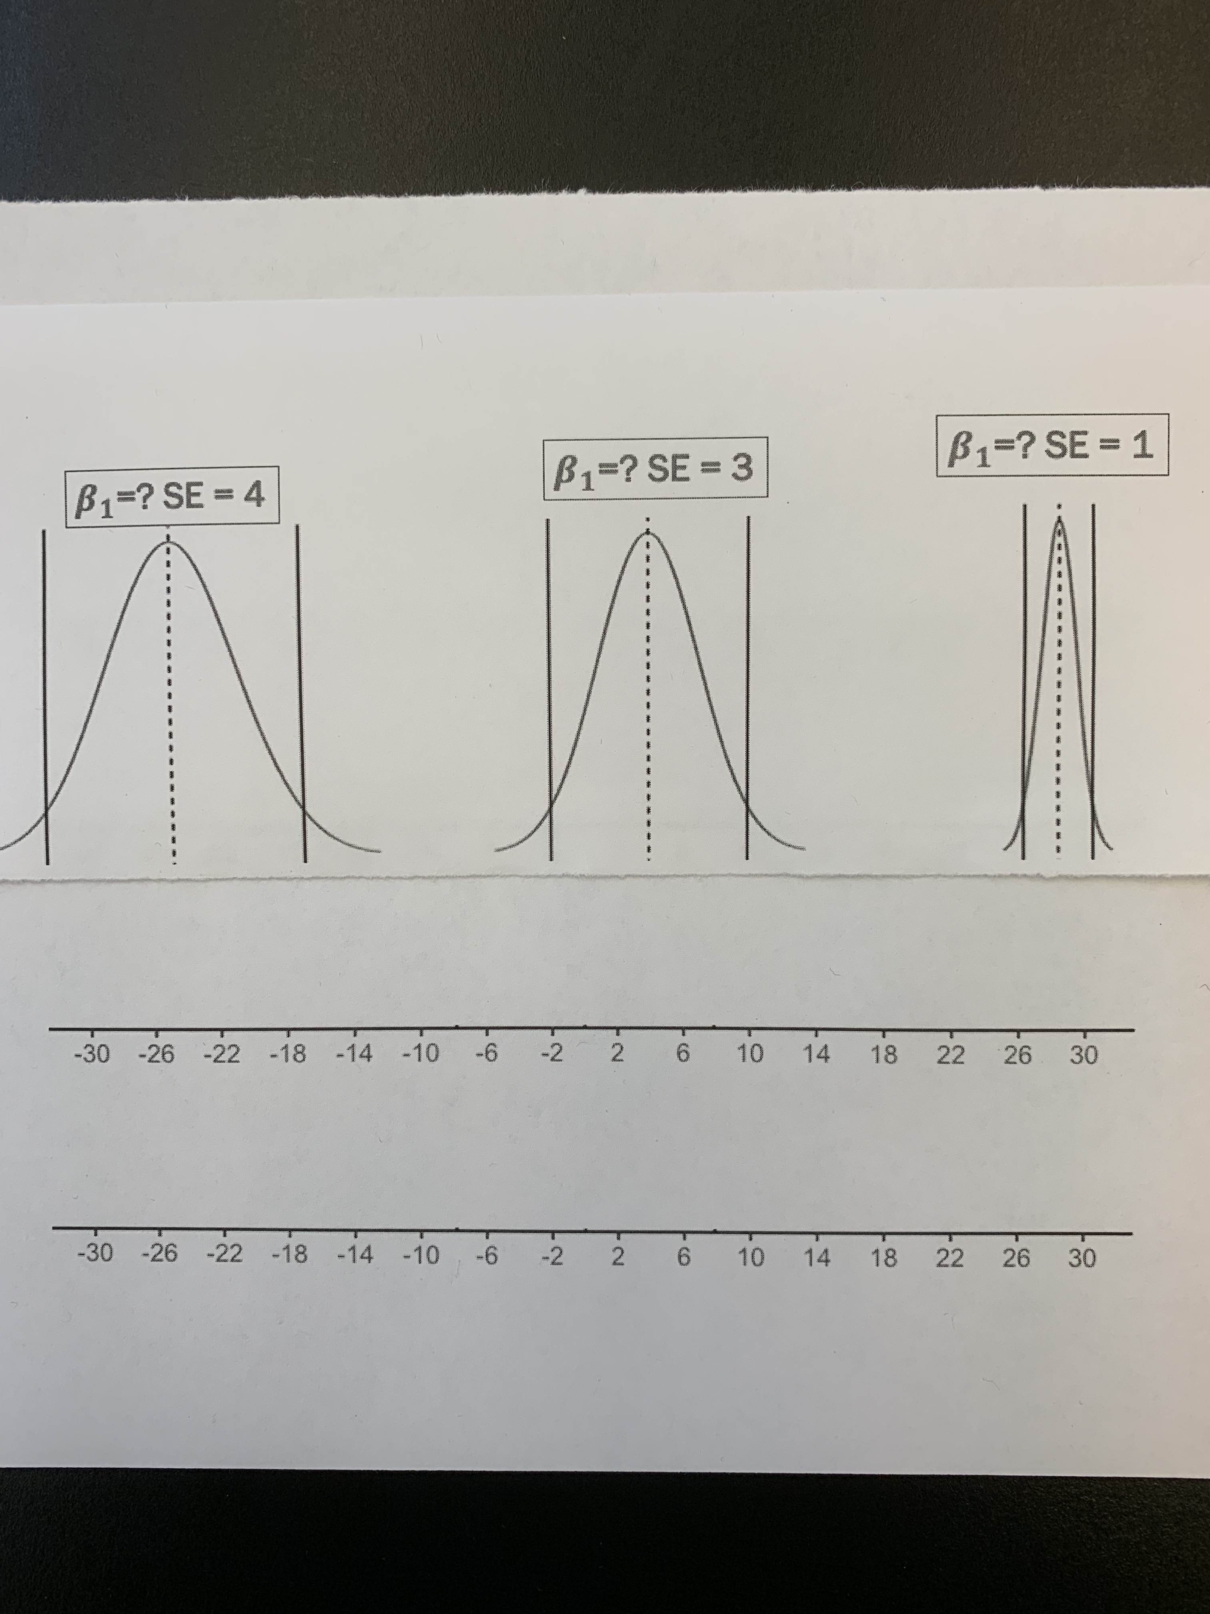
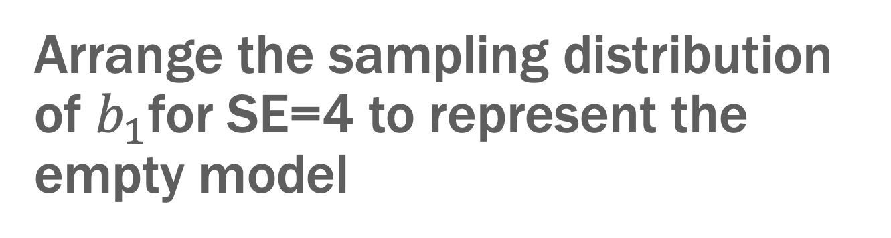
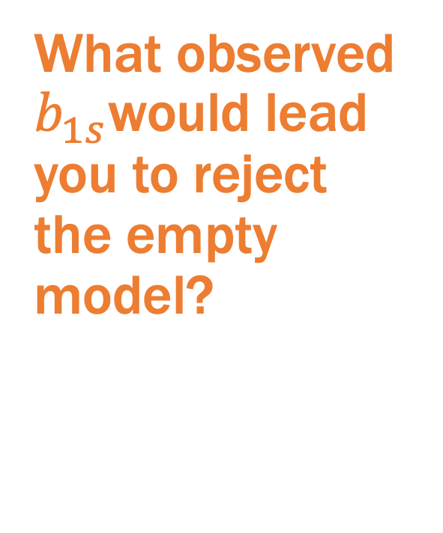
Arrange the sampling distribution of $b_{1}$for SE=4 to represent the empty model
What observed $b_{1s}$would lead you to reject the empty model?

Slide 5
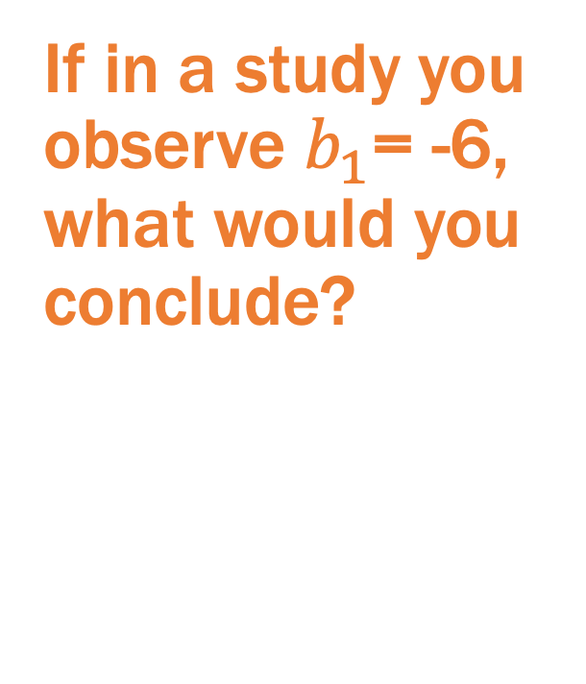
Arrange the sampling distribution of $b_{1}$for SE=4 to represent the empty model
If in a study you observe $b_{1}$= -6, what would you conclude?

Slide 6
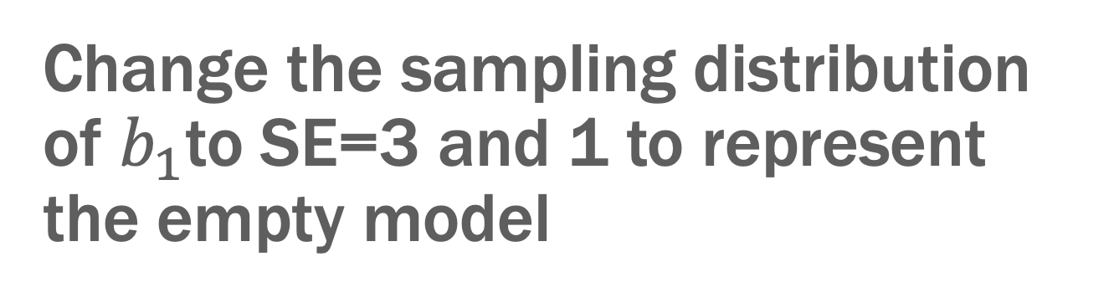
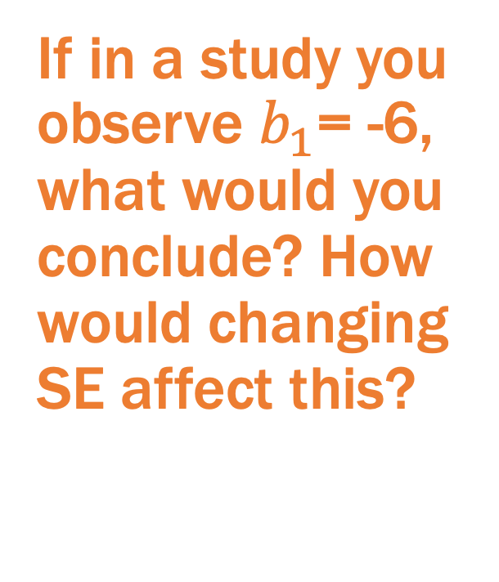
Change the sampling distribution of $b_{1}$to SE=3 and 1 to represent the empty model
If in a study you observe $b_{1}$= -6, what would you conclude? How would changing SE affect this?

Slide 7
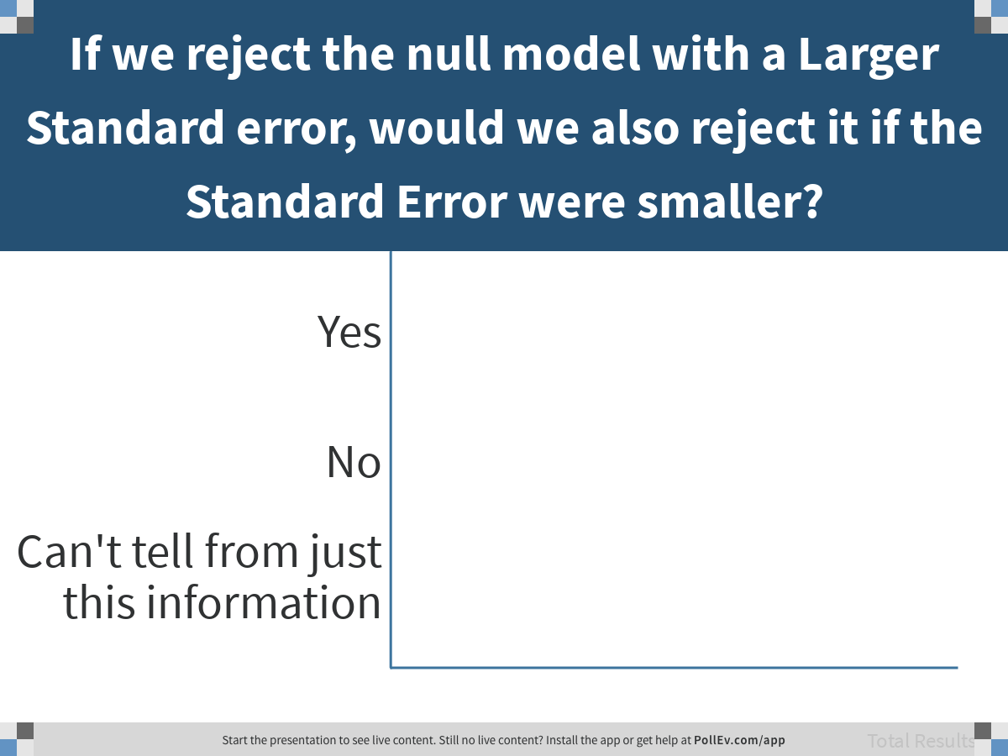
Notes:
If we reject the null model with a Larger Standard error, would we also reject it if the Standard Error were smaller?
https://www.polleverywhere.com/multiple_choice_polls/rQgaEL2vC1kRjb0HeFH6g

Slide 8
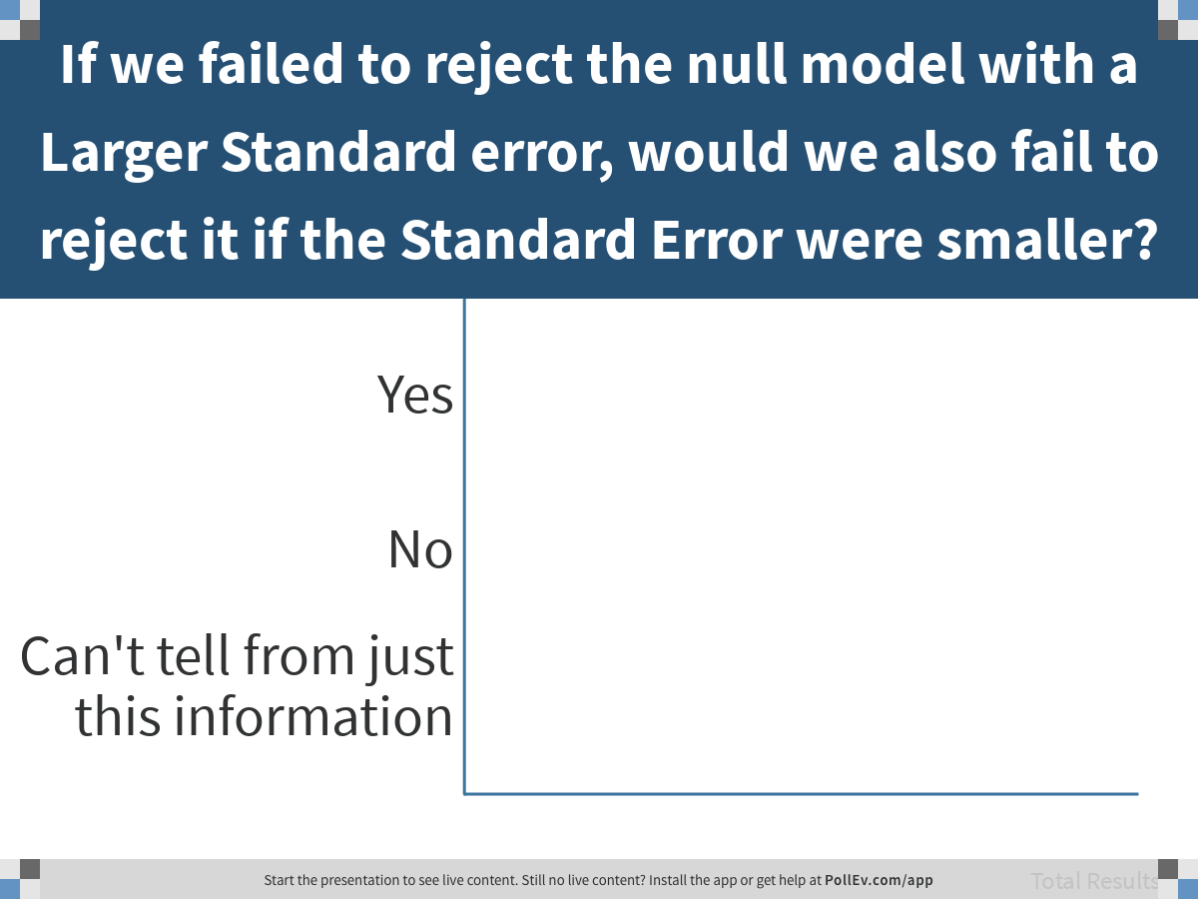
Notes:
If we failed to reject the null model with a Larger Standard error, would we also fail to reject it if the Standard Error were smaller?
https://www.polleverywhere.com/multiple_choice_polls/tGXi5DJ7P1GcsFa788HKV

Slide 9
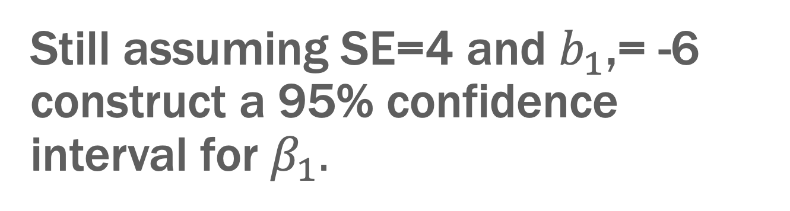
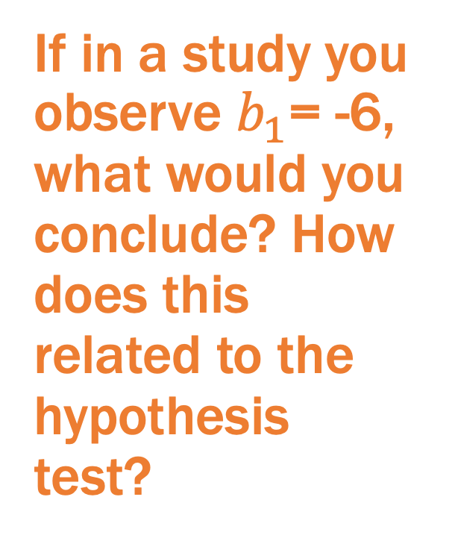
Still assuming SE=4 and $b_{1}$,= -6 construct a 95% confidence interval for $β_{1}.$
If in a study you observe $b_{1}$= -6, what would you conclude? How does this related to the hypothesis test?

Slide 10
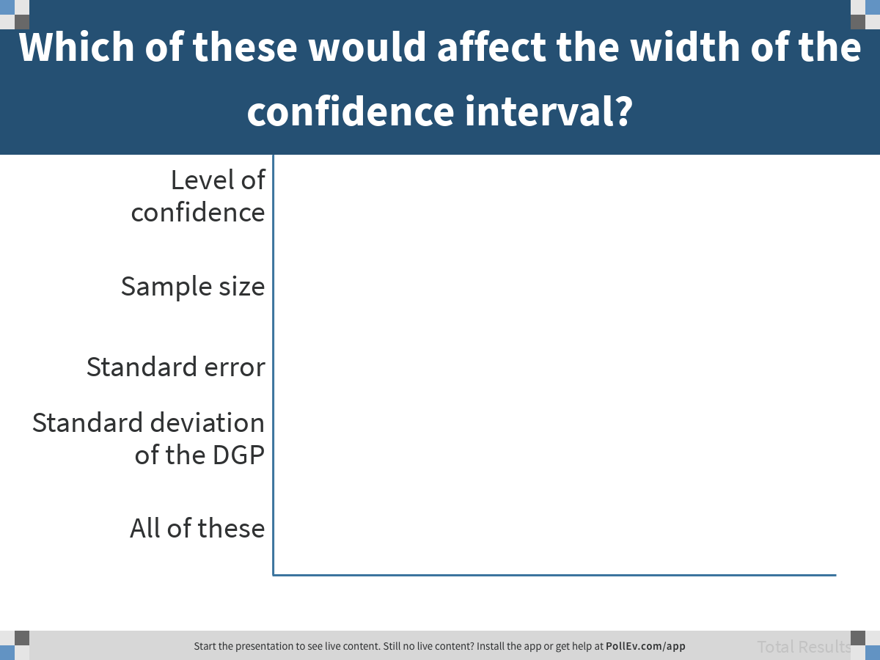
Notes:
Which of these would affect the width of the confidence interval?
https://www.polleverywhere.com/multiple_choice_polls/DaEkNQ6fYK5lEmYMaNOz1

Slide 11
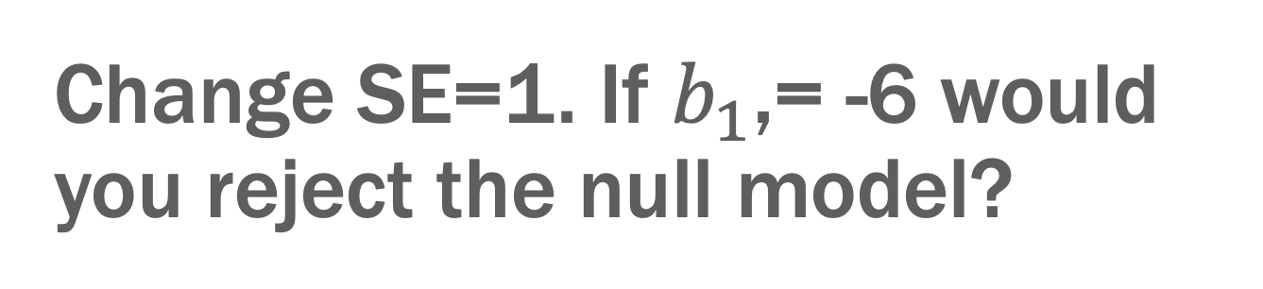
Change SE=1. If $b_{1}$,= -6 would you reject the null model?
Construct confidence interval and compare with hypothesis test.

Slide 12
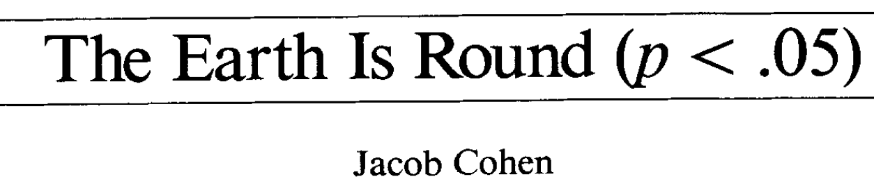

Discuss
The null model can always be rejected if the sample size is large enough.

Slide 13
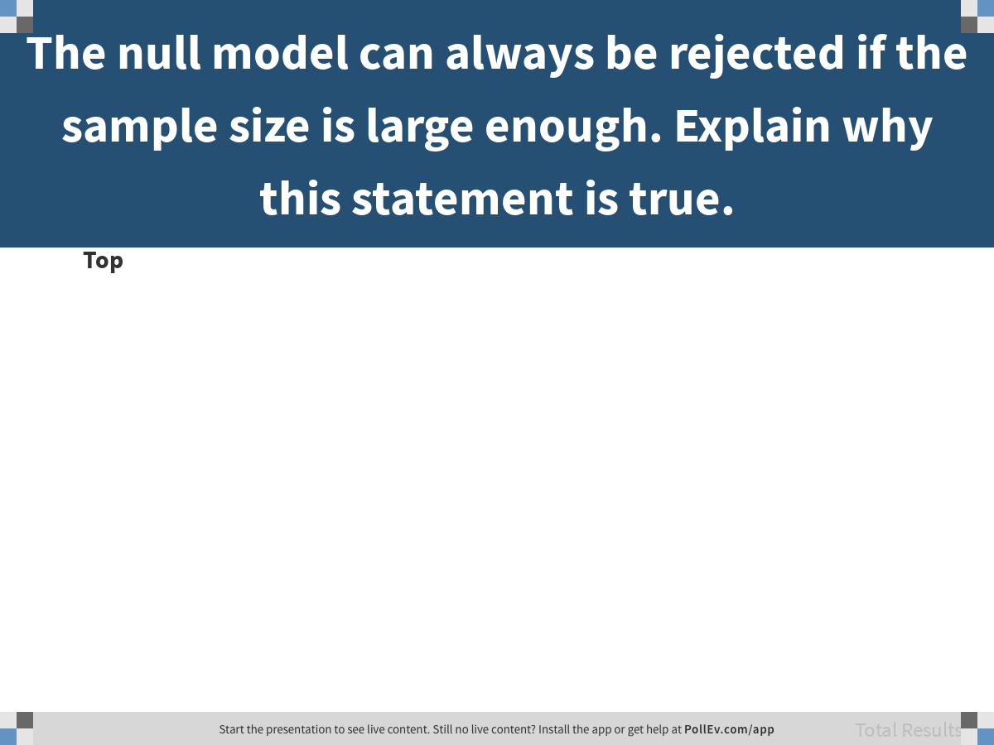
Notes:
The null model can always be rejected if the sample size is large enough. Explain why this statement is true.
https://www.polleverywhere.com/discourses/yUjpWQOxt65rE9oKZlKav

Slide 14
Power and Type II Error

Slide 15
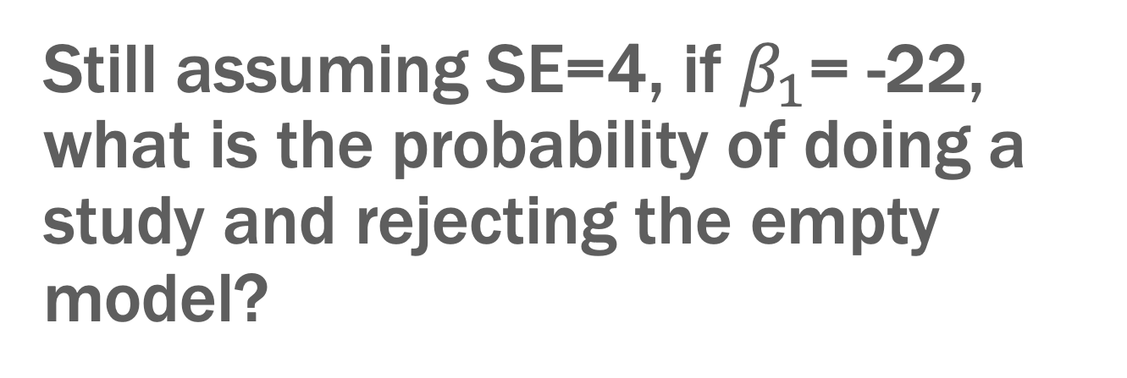
Still assuming SE=4, if $β_{1}$= -22, what is the probability of doing a study and rejecting the empty model?
If we do the study again, what is the probability?
What is chance of mistakenly not rejecting null (Type II error)?

Slide 16

Still assuming SE=4, if $β_{1}$= -16, what is the probability of doing a study and rejecting the empty model?
If we do the study again, what is the probability?
What is chance of mistakenly not rejecting null (Type II error)?

Slide 17
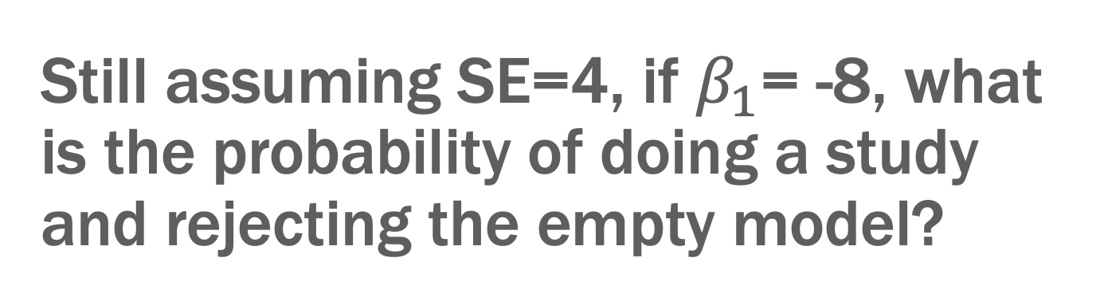
Still assuming SE=4, if $β_{1}$= -8, what is the probability of doing a study and rejecting the empty model?
If we do the study again, what is the probability?
What is chance of mistakenly not rejecting null (Type II error)?

Slide 18
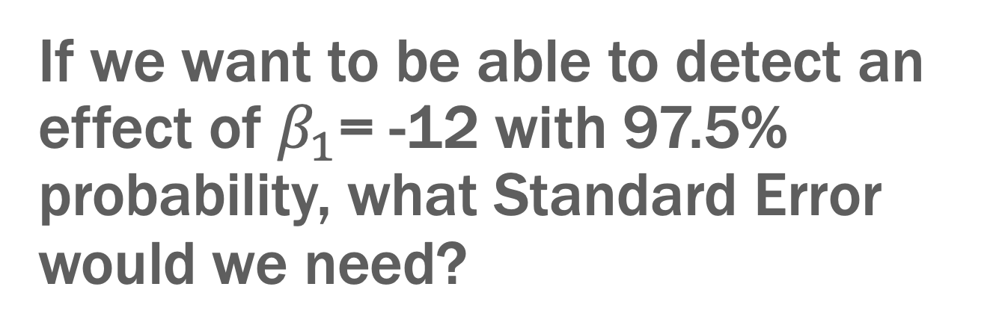
If we want to be able to detect an effect of $β_{1}$= -12 with 97.5% probability, what Standard Error would we need?
Try various Standard Errors
*HINT: make sure to adjust both null and assumed effect distributions

Slide 19
Power + Type II Error = 1.0

